Slide 1


Noida Institute of Engineering and Technology, Greater Noida
Linked Lists
Unit: 3
Data Structures
Mr. Raju
Assistant Professor
Department of CSE(Data Science)
Course Details (B Tech 3rd Sem)

Slide 2
Faculty Introduction
Name : Mr. Raju
Qualification: MTech (Computer Engineering), Ph.D (Pursuing)
Experience: More than 7 years
Subject Taught: Neural Network, DBMS, Object Oriented Programming, Computer Graphics, COA, Digital Image Processing, Computer Application

Slide 3


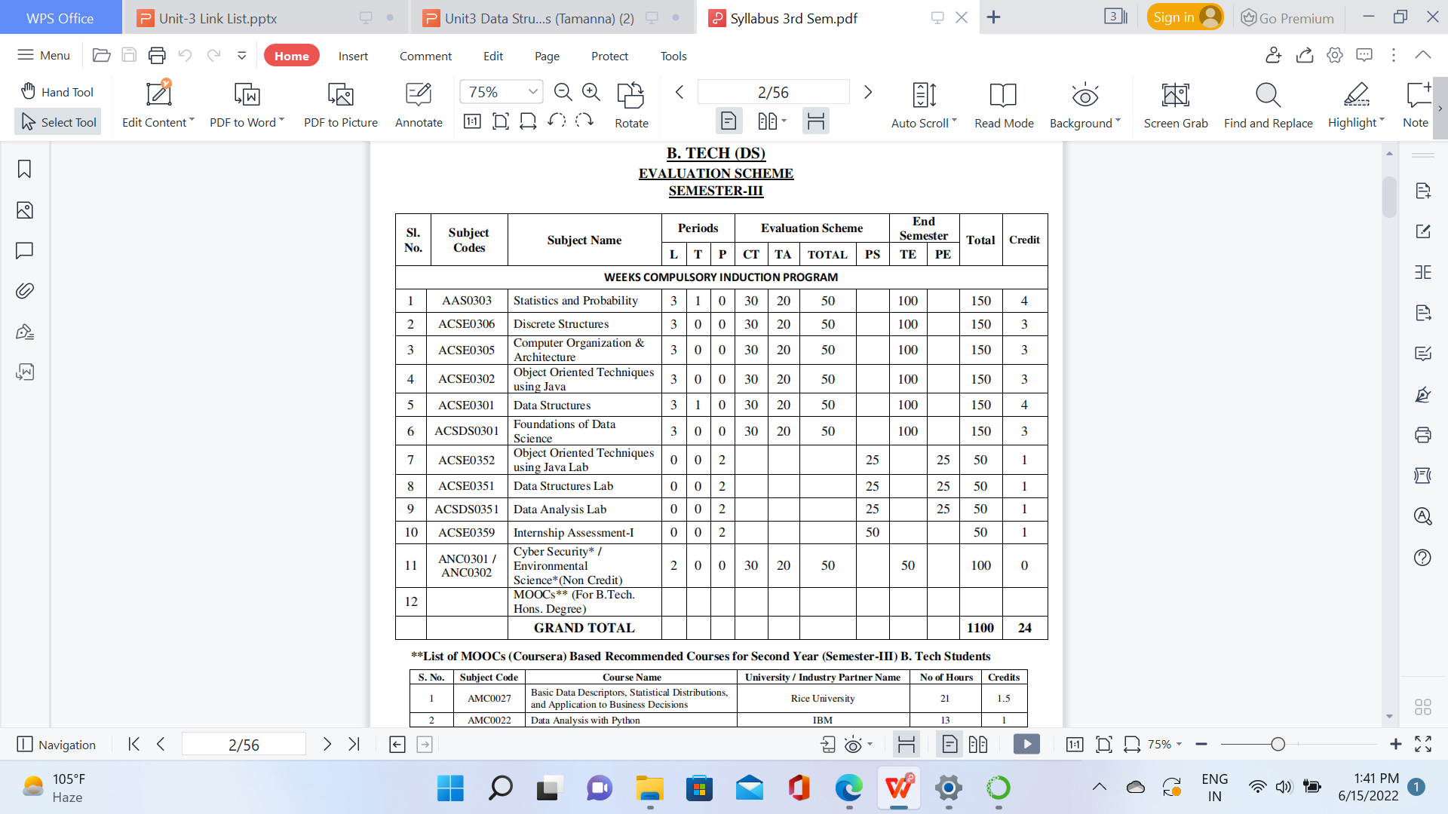
Evaluation Scheme

Slide 4

Syllabus

Slide 5


Syllabus

Slide 6

Syllabus

Slide 7

Syllabus

Slide 8
Unit III Syllabus
Advantages of linked list over array,
Self-referential structure,
Singly Linked List, Doubly Linked List, Circular Linked List.
Operations on a Linked List: Insertion, Deletion, Traversal, Reversal, Searching, Polynomial Representation and Addition of Polynomials.
Implementation of Stack and Queue using Linked lists.

Slide 9
Branch wise Application
A data structure is a particular way of organizing data in a computer so that it can be used effectively.
For example, we can store a list of items having the same data-type using the array data structure.
2D Arrays, commonly known as, matrix, are used in image processing.
It is also used in speech processing, in which each speech signal is an array.

Slide 10
Unit Content
Advantages of Linked List over Array
Singly Linked List
Doubly Linked List
Circular Linked List
Operation on Linked List
Insertion
Deletion
Traversal
Reversal
Searching Polynomial Representation
Addition, Subtraction and Multiplication of Polynomials
Implementation of Stack and Queue using Linked List

Slide 11
Unit Objective
To learn about arrays and linked lists.
To understand different types of arrays and Linked lists.
Basic operations of arrays and linked list.

Slide 12
Course Objective
Introduction to basic data structures.
To know about the basic properties of different data structures.
Classification and operations on data structure
Understand algorithms and their efficiency
Study logical and mathematical description of array and link list.
Implementation of array and link list on computer.
Differentiate the usage of array and link list in different scenarios.

Slide 13
Course Outcome
CO | CO Description | Bloom’s Knowledge Level (KL)
CO 1 | Describe the need of data structure and algorithms in problem solving and analyze Time space trade-off. | K2, K4
CO 2 | Describe how arrays are represented in memory and how to use them for implementation of matrix operations, searching and sorting along with their computational efficiency. | K2, K6
CO 3 | Design, implement and evaluate the real-world applications using stacks, queues and non-linear data structures. | K5, K6
CO 4 | Compare and contrast the advantages and disadvantages of linked lists over arrays and implement operations on different types of linked list. | K4, K6
CO 5 | Identify and develop the alternative implementations of data structures with respect to its performance to solve a real-world problem. | K1, K3, K5, K6

Slide 14
Program Outcomes (POs)
1. Engineering knowledge
2. Problem analysis
3. Design/development of solutions
4. Conduct investigations of complex problems
5. Modern tool usage
6. The engineer and society
7. Environment and sustainability
8. Ethics
9. Individual and team work
10. Communication
11. Project management and finance
12. Life-long learning

Slide 15
CO-PO Mapping
CO-PO correlation matrix of Data Structure (KCS 301)
 | PO1 | PO2 | PO3 | PO4 | PO5 | PO6 | PO7 | PO8 | PO9 | PO10 | PO11 | PO12
ACSE0301.1 | 3 | 3 | 3 | 2 | - | 1 | - | 1 | 2 | 2 | 2 | 2
ACSE0301.2 | 3 | 3 | 2 | 2 | - | 1 | - | 1 | 2 | 2 | 1 | 2
ACSE0301.3 | 3 | 3 | 2 | 2 | - | 1 | - | 1 | 2 | 2 | 2 | 2
ACSE0301.4 | 3 | 3 | 2 | 2 | - | 1 | - | 1 | 2 | 2 | 2 | 2
ACSE0301.5 | 3 | 3 | 3 | 3 | 2 | 2 | 2 | 2 | 3 | 3 | 3 | 3
Average | 3 | 3 | 2.4 | 2.2 | 0.4 | 1.2 | 0.4 | 1.2 | 2.2 | 2.2 | 2 | 2.2

Slide 16
Program Specific Outcomes (PSOs)
On successful completion of graduation degree the Engineering graduates will be able to:
PSO1: The ability to design and develop the hardware sensor device and related interfacing software system for solving complex engineering problem.
PSO2: The ability to understanding of Inter disciplinary computing techniques and to apply them in the design of advanced computing .
PSO 3: The ability to conduct investigation of complex problem with the help of technical, managerial, leadership qualities, and modern engineering tools provided by industry sponsored laboratories.
PSO 4: The ability to identify, analyze real world problem and design their solution using artificial intelligence ,robotics, virtual. Augmented reality ,data analytics, block chain technology and cloud computing.

Slide 17
CO-PSO Mapping
Mapping of Program Specific Outcomes and Course Outcomes
 | PSO1 | PSO2 | PSO3 | PSO4
ACSE0301.1 | 3 | 3 | 2 | 2
ACSE0301.2 | 3 | 3 | 2 | 3
ACSE0301.3 | 3 | 3 | 2 | 2
ACSE0301.4 | 3 | 3 | 3 | 3
ACSE0301.5 | 3 | 3 | 3 | 3
Average | 3 | 3 | 2.4 | 2.6

Slide 18
Prerequisite and Recap
Interest
Get Familiar with any programming language. C, C++ and Python.
Start learn Data Structure and Algorithm daily.
Practice ! Because practice makes you perfect.

Slide 19
Faculty Video Links, Youtube & NPTEL Video Links and Online Courses Details
Youtube/other Video Links
Implementation of link list
https://www.youtube.com/watch?v=6wXZ_m3SbEs
Polynomial addition using link list
https://www.youtube.com/watch?v=V_ZNKu_pUPQ

Slide 20
Basic Terminology(CO1)
Linked List
Doubly Linked List
Circularly Linked List

Slide 21
Topic Objective
To understand linked list and the operations of linked list.
To implement Linked list program using Python

Slide 22
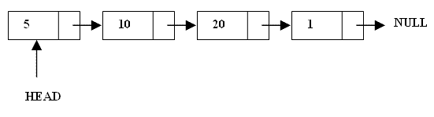

Linked List
A linked list is a linear data structure.
Nodes make up linked lists.
Nodes are structures made up of data and a pointer to another node.
Usually the pointer is called next.

Slide 23
Linked List
A linked list is a sequence of data structures, which are connected together via links.
Linked List is a sequence of links which contains items. Each link contains a connection to another link. Linked list is the second most-used data structure after array. Following are the important terms to understand the concept of Linked List.
Link − Each link of a linked list can store a data called an element.
Next − Each link of a linked list contains a link to the next link called Next.
Linked List − A Linked List contains the connection link to the first link called First.

Slide 24
Linked List
Introduction to Linked List
The elements of a linked list are not stored in adjacent memory locations as in arrays.
It is a linear collection of data elements, called nodes, where the linear order is implemented by means of pointers.

Slide 25
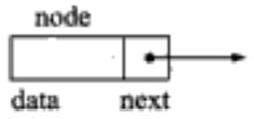
Linked List
Continued….
In a linear or single-linked list, a node is connected to the next node by a single link.
A node in this type of linked list contains two types of fields
data: which holds a list element
next: which stores a link (i.e. pointer) to the next node in the list.

Slide 26
Linked List
Continued….
The structure defined for a single linked list is implemented as follows:
struct Node{
int info;
struct Node * next;
}
The structure declared for linear linked list holds two members
An integer type variable ‘data’ which holds the elements and
Another type ‘node’, which has next, which stores the address of the next node in the list.

Slide 27
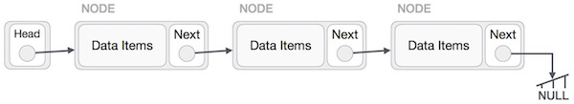
Linked List Representation
Linked list can be visualized as a chain of nodes, where every node points to the next node.
As per the above illustration, following are the important points to be considered.
Linked List contains a link element called first.
Each link carries a data field(s) and a link field called next.
Each link is linked with its next link using its next link.
Last link carries a link as null to mark the end of the list.

Slide 28
Properties of linked list
The nodes in a linked list are not stored contiguously in the memory
You don’t have to shift any element in the list
Memory for each node can be allocated dynamically whenever the need arises.
The size of a linked list can grow or shrink dynamically

Slide 29
Basic Operations on Linked List
Following are the basic operations supported by a list.
Insertion − Adds an element at the beginning of the list.
Deletion − Deletes an element at the beginning of the list.
Display − Displays the complete list.
Search − Searches an element using the given key.
Delete − Deletes an element using the given key.

Slide 30
Arrays & Linked list
Arrays | Linked list
Fixed size: Resizing is expensive | Dynamic size
Insertions and Deletions are inefficient: Elements are usually shifted | Insertions and Deletions are efficient: No shifting
Random access i.e., efficient indexing | No random access → Not suitable for operations requiring accessing elements by index such as sorting
No memory waste if the array is full or almost full; otherwise may result in much memory waste. | Since memory is allocated dynamically(acc. to our need) there is no waste of memory.
Sequential access is faster [Reason: Elements in contiguous memory locations] | Sequential access is slow [Reason: Elements not in contiguous memory locations]

Slide 31
Introduction to Linked List
Create Empty Link List
Insert First Node
3) Insert Second Node
Struct Node *Head;
Head = NULL;
Head
NULL
Struct Node *NewNode;
NewNode = (struct Node*)malloc(sizeof(struct Node));
Head
100
10
NULL
NewNode = 100
100
Head
10
5
NULL
100
200
Struct Node *temp=head;
NewNode = (struct Node*)malloc(sizeof(struct Node));
temp->next = NewNode;

Slide 32
Types of Link List
Following are the various types of linked list.
Simple Linked List − Item navigation is forward only.
Doubly Linked List − Items can be navigated forward and backward.
Circular Linked List − Last item contains link of the first element as next
Circular Doubly Linked List − Last item contains link of the first element as next and the first element has a link to the last element as previous. Items can be navigated forward and backward.

Slide 33
Singly Linked list
A singly linked list is a dynamic data structure which may grow or shrink, and growing and shrinking depends on the operation made.
In this type of linked list each node contains two fields one is data field which is used to store the data items and another is next field that is used to point the next node in the list.
info
next
info
next
info
next
5
3
8
null

Slide 34
Creating an empty list
void createEmptyList(NodeType *head)
{
head=NULL;
}
OR SIMPLY
NodeType *head =Null;

Slide 35
Creation of Linked List using Python
# Node class
class Node:
# Function to initialize the node object
def __init__(self, data):
self.data = data # Assign data
self.next = None # Initialize
# next as null
# Linked List class
class LinkedList:
# Function to initialize the Linked
# List object
def __init__(self):
self.head = None

Slide 36
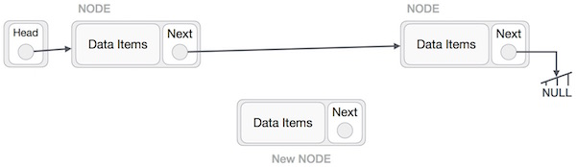
Insertion in a Linked List
Adding a new node in linked list is a more than one step activity. We shall learn this with diagrams here. First, create a node using the same structure and find the location where it has to be inserted.

Slide 37
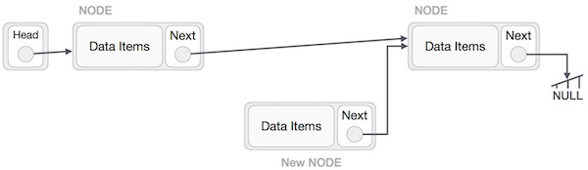
Insertion in a Linked List (contd..)
Imagine that we are inserting a node B (NewNode), between A (LeftNode) and C (RightNode).
Then point B.next to C −
NewNode.next −> RightNode;
It should look like this −

Slide 38
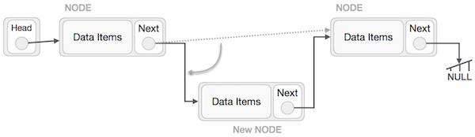
Insertion in a Linked List (contd..)
Now, the next node at the left should point to the new node.
LeftNode.next −> NewNode;

Slide 39
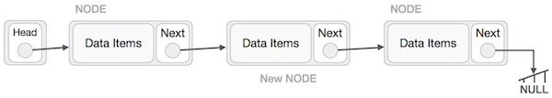
Insertion in a Linked List (contd..)
This will put the new node in the middle of the two. The new list should look like this :−
Similar steps should be taken if the node is being inserted at the beginning of the list.
While inserting it at the end, the second last node of the list should point to the new node and the new node will point to NULL.

Slide 40
Python program to insert a node in Linked List
# Node class
class Node:
# Function to initialise the node object
def __init__(self, data):
self.data = data # Assign data
self.next = None # Initialize next as null
# Linked List class contains a Node object
class LinkedList:
# Function to initialize head
def __init__(self):
self.head = None
# Code execution starts here
if __name__=='__main__':
# Start with the empty list
llist = LinkedList()
llist.head = Node(1)
second = Node(2)
third = Node(3)
llist.head.next = second; # Link first node with second
second.next = third; # Link second node with the third node

Slide 41
Inserting an Element
Introduction to Link List(CO1)
While inserting an element or a node in a linked list, we have to do following things:
Allocate a node
Assign a data to info field of the node.
Adjust a pointer
We can insert an element in following places
At the beginning of the linked list
At the end of the linked list
At the specified position in a linked list

Slide 42
An algorithm to insert a node at the beginning of the singly linked list
Introduction to Link List(CO1)
Let *head be the pointer to first node in the current list
Create a new node using malloc function
NewNode=(NodeType*)malloc(sizeof(NodeType));
Assign data to the info field of new node
NewNode->info=newItem;
Set next of new node to head
NewNode->next=head;
Set the head pointer to the new node
head=NewNode;
End

Slide 43
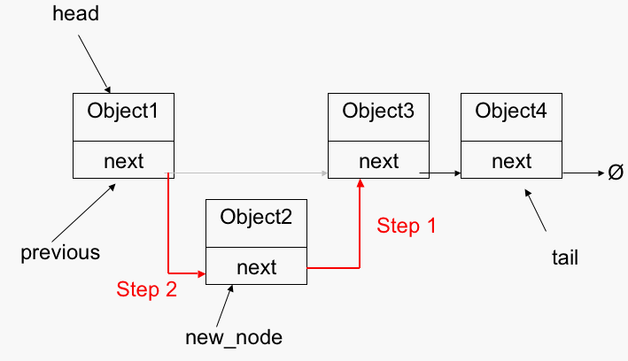
Introduction to Link List(CO1)
Insert A Node At The Beginning Of The Singly Linked List

Slide 44
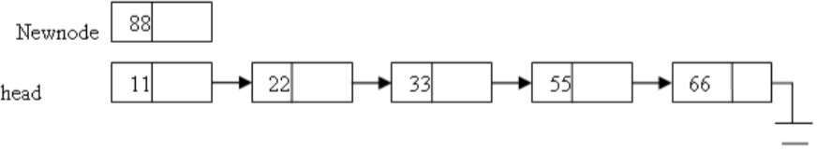
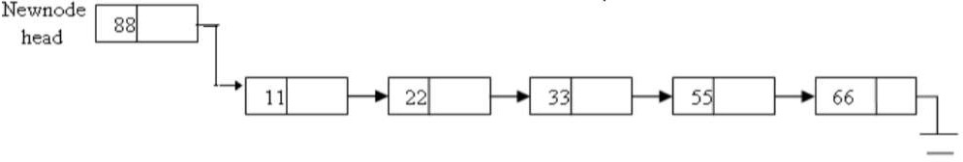
Inserting a node at the beginning of the singly linked list
Introduction to Link List(CO1)

Slide 45
An algorithm to insert a node at the end of the singly linked list
Introduction to Link List(CO1)
let *head be the pointer to first node in the current list
Create a new node using malloc function
NewNode=(NodeType*)malloc(sizeof(NodeType));
Assign data to the info field of new node
NewNode->info=newItem;
Set next of new node to NULL
NewNode->next=NULL;
if (head ==NULL) then
Set head =NewNode.and exit.
Set temp=head;
while(temp->next!=NULL)
temp=temp->next; //increment temp
Set temp->next=NewNode;
End

Slide 46
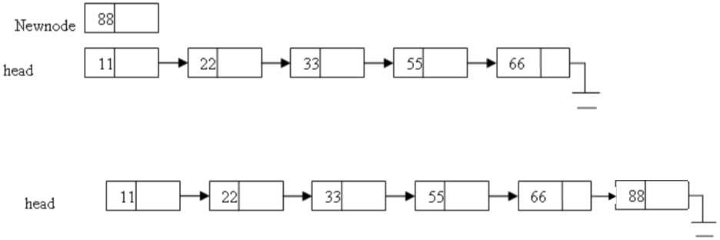
Introduction to Link List(CO1)
An algorithm to insert a node at the end of the singly linked list

Slide 47
An algorithm to insert a node after the given node in singly linked list
Introduction to Link List(CO1)
let *head be the pointer to first node in the current list and *p be the pointer to the node after which we want to insert a new node.
Create a new node using malloc function
NewNode=(NodeType*)malloc(sizeof(NodeType));
Assign data to the info field of new node
NewNode->info=newItem;
Set next of new node to next of p
NewNode->next=p->next;
Set next of p to NewNode
p->next =NewNode
End

Slide 48
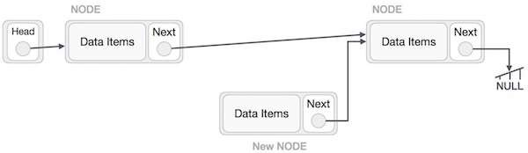
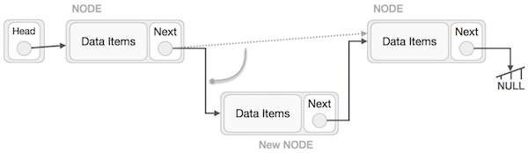
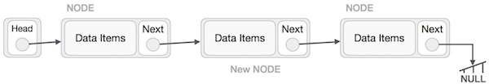
Introduction to Link List(CO1)

Slide 49
An algorithm to insert a node at the specified position in a linked list
Introduction to Link List(CO1)
let *head be the pointer to first node in the current list
Create a new node using malloc function
NewNode=(NodeType*)malloc(sizeof(NodeType));
Assign data to the info field of new node
NewNode->info=newItem;
Enter position of a node at which you want to insert a new node. Let this position is pos.
Set temp=head;
if (head ==NULL)then
printf(“void insertion”); and exit(1).
for(i=1; i<pos; i++)
temp=temp->next;
Set NewNode->next=temp->next;
set temp->next =NewNode..
End

Slide 50
Deleting Nodes
Introduction to Link List(CO1)
A node may be deleted:
From the beginning of the linked list
From the end of the linked list
From the specified position in a linked list

Slide 51
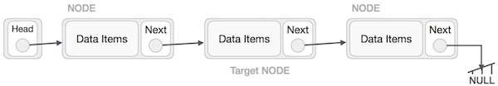
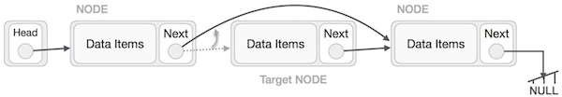
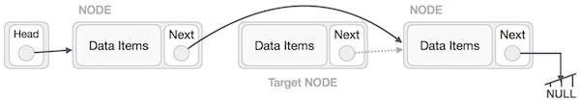
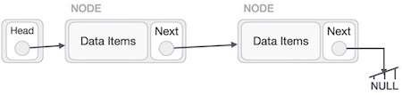
Introduction to Link List(CO1)
Deleting Nodes

Slide 52
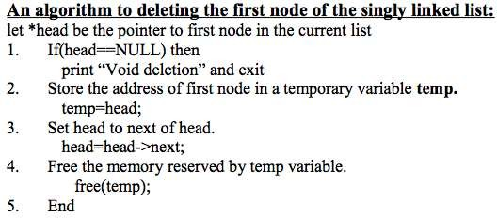
Introduction to Link List(CO1)

Slide 53
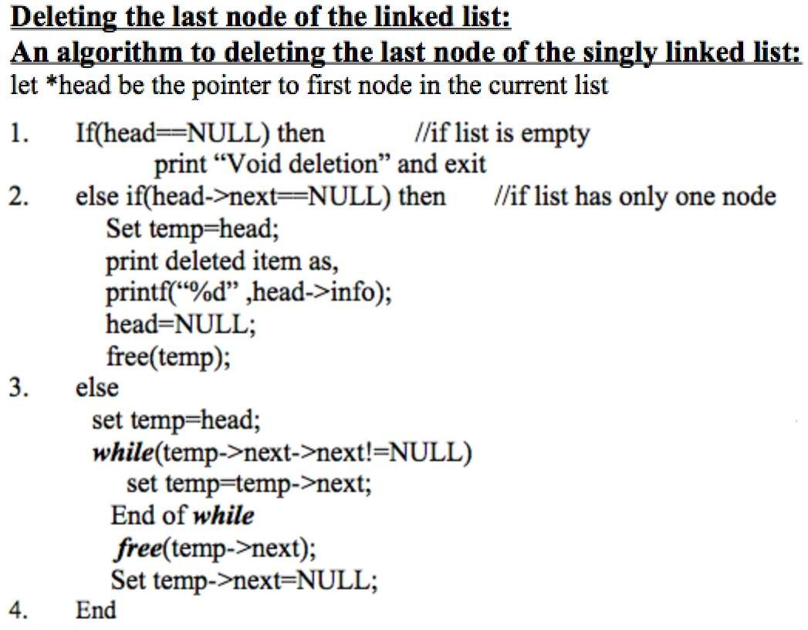
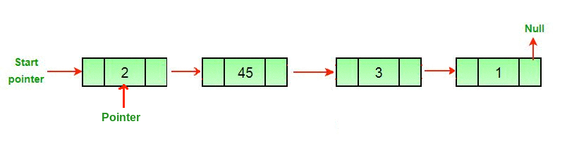
Introduction to Link List(CO1)

Slide 54
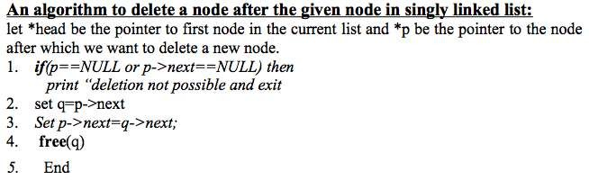
Introduction to Link List(CO1)

Slide 55
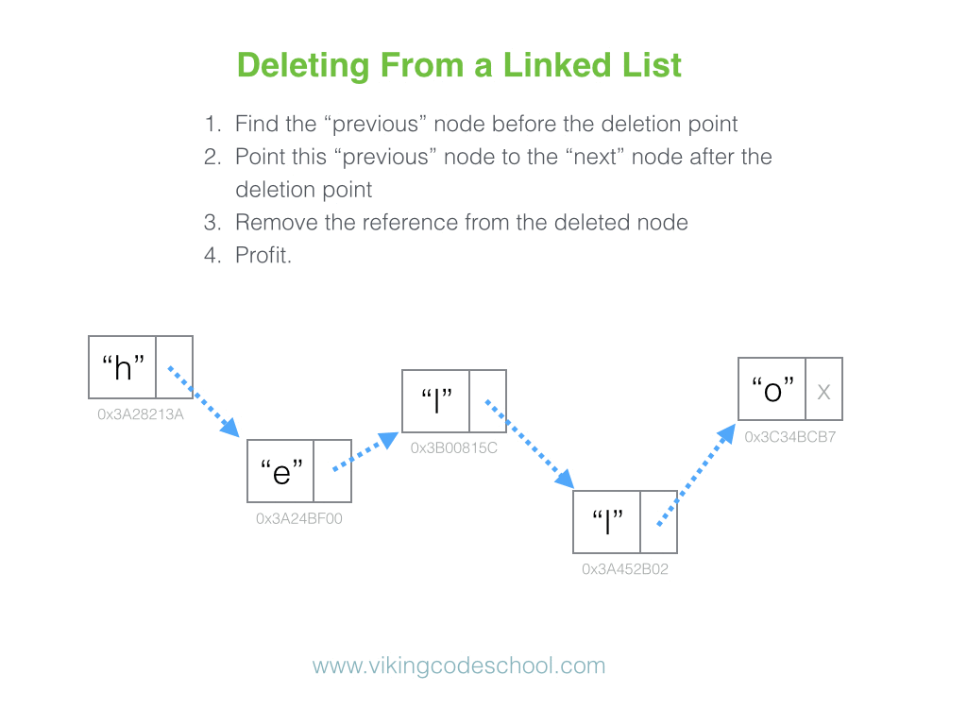
Introduction to Link List(CO1)

Slide 56
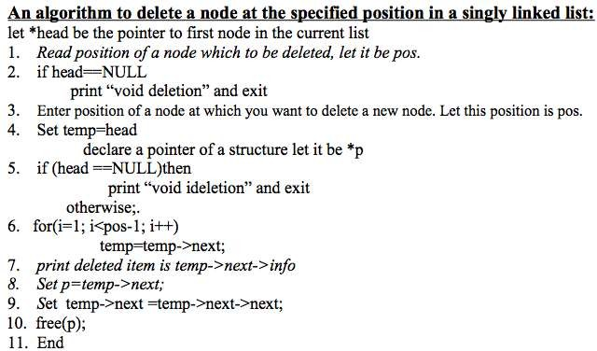
Introduction to Link List(CO1)

Slide 57
Searching an item in a linked list
Introduction to Link List(CO1)
Let *head be the pointer to first node in the current list
If head==Null
Print “Empty List”
Else, enter an item to be searched as key
Set temp==head
While temp!=Null
If (temp->info == key)
Print “search success”
temp=temp->next;
If temp==Null
Print “Unsuccessful search”

Slide 58
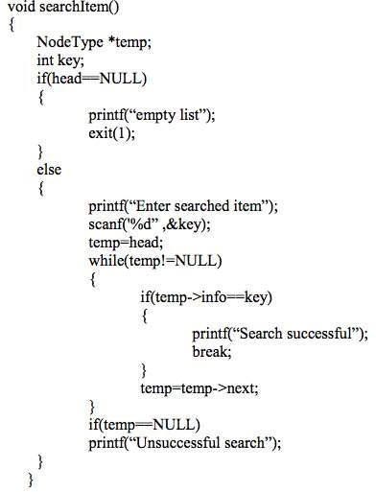
Introduction to Link List(CO1)

Slide 59
Introduction to Link List(CO1)
Delete particular node from link list
Let *head be the pointer to first node in the current list, Declared Q pointer
If head==Null
Print “Empty List”
Else, enter a value of node, you want to delete.
Set temp = head; Declare Prev pointer.
// If head node itself holds the key to be deleted
if (head != NULL && head->data == key)
{
head = head->next; // Changed head
free(temp); // free old head
return;
}

Slide 60
Introduction to Link List(CO1)
Delete particular node from link list
// Search for the key to be deleted, keep track of the
// previous node as we need to change 'prev->next'
while (temp != NULL && temp->data != key)
{
prev = temp;
temp = temp->next;
}
// If key was not present in linked list
if (temp == NULL) return;
// Unlink the node from linked list
prev->next = temp->next;
free(temp); // Free memory

Slide 61
Introduction to Link List(CO1)
Insert after a particular node in the link list
Let *head be the pointer to first node in the current list, Declared Q pointer
If head==Null
Print “Empty List”
Else, enter a value of node, after which you want to insert.
Create newnode using malloc function, enter data in info field, and store null in next field.
Set temp=head
While temp!=Null{
If (temp->info == key) {
newnode->next = temp->next;
temp->next = newnode;
}
temp=temp->next;}
If temp==Null
Print “Unsuccessful search”

Slide 62
Introduction to Link List(CO1)
Reverse a Single Link list
void reverseList()
{
struct node *prevNode, *curNode;
if(head != NULL) {
prevNode = head;
curNode = head->next;
head = head->next;
prevNode->next = NULL; // Make first node as last node while(head != NULL) {
head = head->next;
curNode->next = prevNode;
prevNode = curNode;
curNode = head;
}
head = prevNode; // Make last node as head printf("SUCCESSFULLY REVERSED LIST\n");
}
}

Slide 63
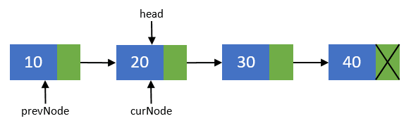
Introduction to Link List(CO1)
1. Steps to reverse a Singly Linked List
Make prevNode points to first node i.e. prevNode = head.
head should now point to its next node i.e. the second node head = head->next.
curNode should also points to the second node i.e. curNode = head.

Slide 64
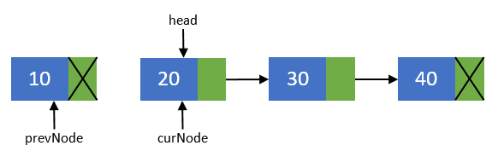
Introduction to Link List(CO1)
2. Now, disconnect the previous node i.e. the first node from others.
We will make sure that it points to none.
As this node is going to be our last node. Perform operation prevNode->next = NULL.

Slide 65
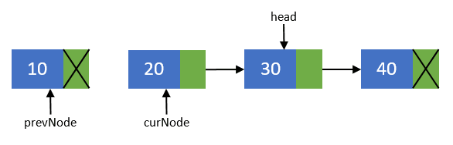
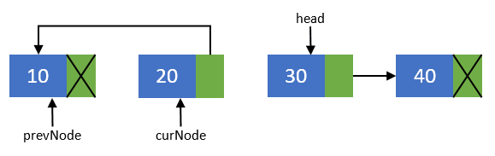
Introduction to Link List(CO1)
3. Move head node to its next node i.e. head = head->next.
4. Now, re-connect the current node to its previous node i.e. curNode->next = prevNode;.

Slide 66
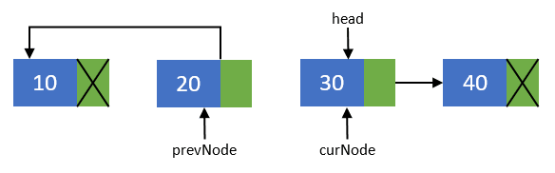
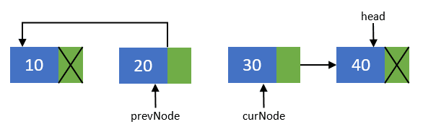
Introduction to Link List(CO1)
5. Point the previous node to current node and current node to head node.
Means they should now point to prevNode = curNode; and curNode = head.
6. Repeat steps 3-5 till head pointer becomes NULL.
3.head = head->next.
4.curNode->next = prevNode
5.prevNode =curNode; curNode = head

Slide 67
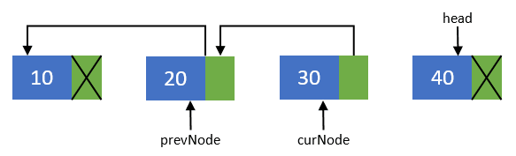
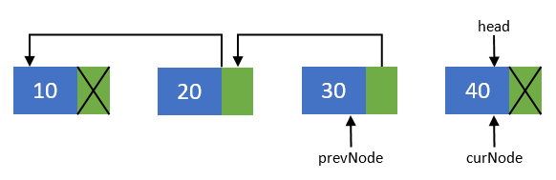
Introduction to Link List(CO1)
3.head = head->next.
4.curNode->next = prevNode
5.prevNode =curNode; curNode = head

Slide 68
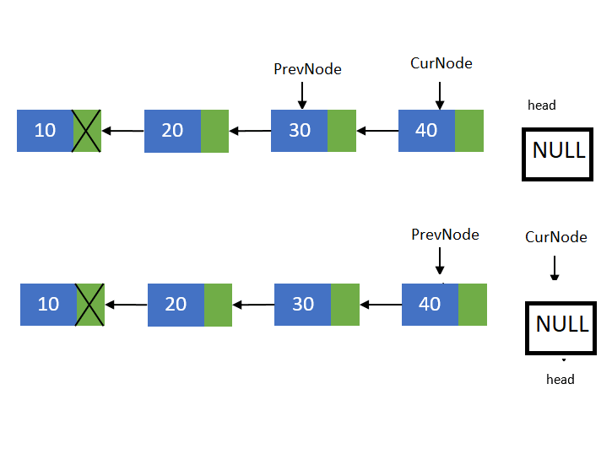
3.head = head->next.
4.curNode->next = prevNode
5.prevNode =curNode; curNode = head

Slide 69
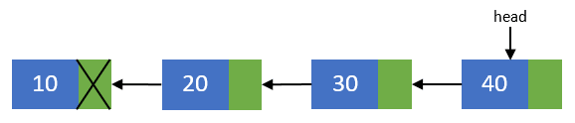
Introduction to Link List(CO1)
7. Now, after all nodes has been re-connected in the reverse order.
Make the last node as the first node.
Means the head pointer should point to prevNode pointer.
Perform head = prevNode;.
Finally you end up with a reversed linked list of its original.

Slide 70
Circular Linked List(CO1)
Circular linked list is a variation of linked list in which the first elements points to the next element and the last element points to the first element.
Both singly and doubly linked list can be made into a circular linked list.
Circular linked list can be used to help traverse the same list again and again if needed.

Slide 71
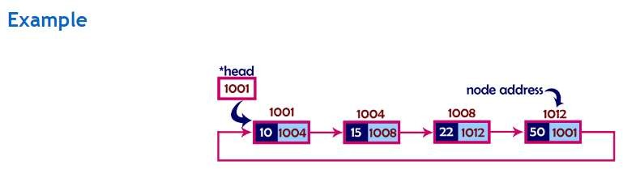
Circular Link List(CO1)
Fun fact:
If you are worried about its implementation, then stop doing that because instead of placing NULL at the last node’s address field you are placing the address of very first node!

Slide 72
Circular linked list vs. Linear linked list
Circular Link List(CO1)
A circularly linked list may be a natural option to represent arrays
that are naturally circular, e.g. the corners of a polygon, a pool
of buffers that are used and released in FIFO order, or a set of processes that should be time-shared. In these applications, a pointer to any node serves as a handle to the whole list.
With a circular list, a pointer to the last node gives easy access also to the first node, by following one link. Thus, in applications that require access to both ends of the list, a circular structure allows one to handle the structure by a single pointer, instead of two.
The simplest representation for an empty circular list (when such a thing makes sense) is a null pointer, indicating that the list has no nodes. Without this choice, many algorithms have to test for this special case, and handle it separately. By contrast, the use of null to denote an empty linear list is more natural and often creates fewer special cases.

Slide 73
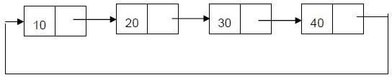
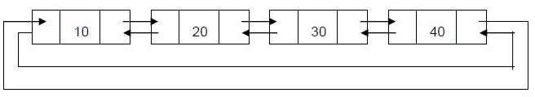
Types of circular linked list:
Circular Link List(CO1)
1. Singly: The last node points to the first node and there is only
link between the nodes of linked list.
2. Doubly: The last node points to the first node and there are two links between the nodes of linked list.

Slide 74
Advantages of Circular linked lists:
Circular Link List(CO1)
Any node can be a starting point. We can traverse the whole list by starting from any point. We just need to stop when the first visited node is visited again.
Circular lists are useful in applications to repeatedly go around the list. For example: when multiple applications are running on a PC, it is common for the operating system to put the running applications on a list and then to cycle through them, giving each of them a slice of time to execute, and then making them wait while the CPU is given to another application. It is convenient for the operating system to use a circular list so that when it reaches the end of the list it can cycle around to the front of the list.
Circular Doubly Linked Lists are used for implementation of advanced data structures like Fibonacci Heap.

Slide 75
Disadvantages of Circular linked list
Circular Link List(CO1)
Depending on the implementation, inserting at start of list would require doing a search for last node which could be expensive.
Finding end of the list and loop control is harder ( no NULL’s to mark the beginning and end).

Slide 76
Operations on singly circular linked list
Circular Link List(CO1)
Insertion
Deletion
Display

Slide 77
Insertion :
Circular Link List(CO1)
Insertion can be of three types.
▫ Insert at first
▫ Insert at last
▫ Insert after constant
Note: insertion after constant in circular and linear linked list is exact same .

Slide 78
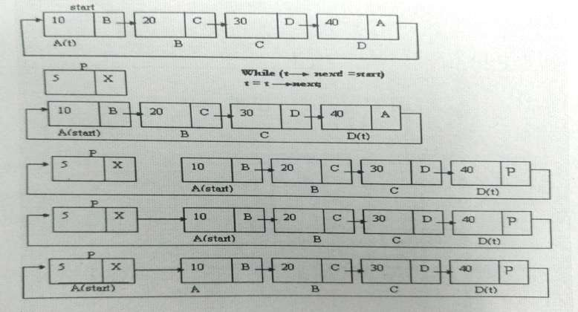
Insertion at first
Circular Link List(CO1)

Slide 79
Algorithm
Circular Link List(CO1)
Program
Void addfront()
{
struct node *t=start;
struct node *n=(struct node*)malloc(sizeof(struct node));
printf(“\nenter the information”); scanf(“%d”,&n->info);
Start.
Declare struct node *t.
Set t:=start.
Create a new node n by malloc function and enter the information in info part.
Check if start=NULL set start=n
set start->next=start. else
Set n->next=start.

Slide 80
Algorithm
Circular Link List(CO1)
Program
if(start==NULL)
{
start=n;
start->next=start;
}
else
{
n->next=start; while(t->next!=start) t=t->next;
t->next=n; start=n;
}
Repeat step(a)
while(t->next!=start)
▫ (a) set t:=t->next.
[end of loop]
Set t->next=n.
Set start=n. [end if]
Stop.

Slide 81
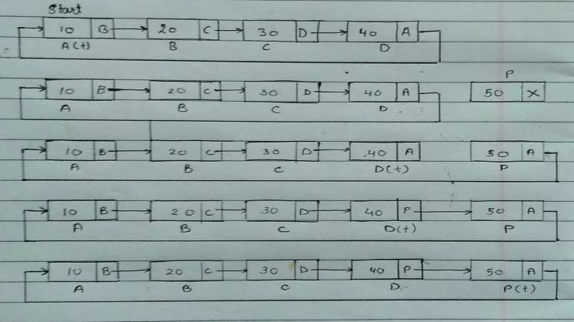
Insert at last
Circular Link List(CO1)

Slide 82
Algorithm
Circular Link List(CO1)
Program
Void addlast()
{
struct node *t=start;
Start.
Declare struct node *t.
Set t:=start.
Create a new node n by malloc function and enter the information in info part.
Check if start=NULL then,
set start:=n.
set start->next:=start. Otherwise
Set n->next:=start.
struct node *n=(struct node*)malloc(sizeof(struct node));
printf(“\nenter the information”); scanf(“%d”,&n->info);

Slide 83
Algorithm
Circular Link List(CO1)
Program
if(start==NULL)
{
start=n;
start->next=start;
}
else
{
n->next=start; while(t->next!=start) t=t->next;
t->next=n;
}
Repeat step(a)
while(t!=NULL)
▫ (a) set t:=t->next.
[end of loop]
Set t->next=n. [end if]
Stop.

Slide 84
Deletion :
Circular Link List(CO1)
Deletion can be of three types.
▫ Delete from front
▫ Delete from last
▫ Deletion from mid
Note: deletion from mid in circular and linear linked list is exact same .

Slide 85
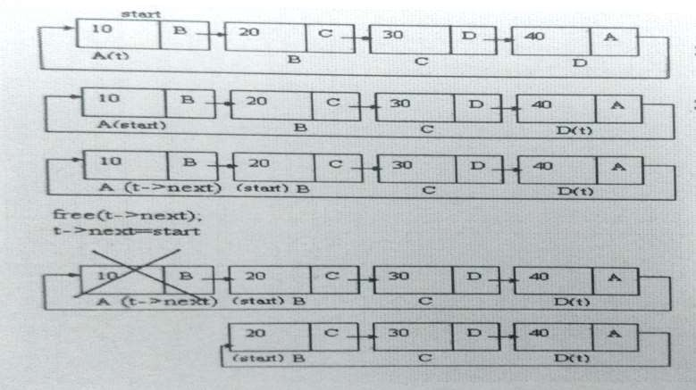
Delete from front
Circular Link List(CO1)

Slide 86
Algorithm
Circular Link List(CO1)
Program
start.
Check if (start=NULL) then,
print “empty list”
Check if
(start->next=start) then,
declare free (t)
set start:=NULL otherwise
Repeat step(a) while(t->next!=start)
▫ (a) set t:=t->next
[end of loop]
Void delfront()
{
struct node *t=start; if (start==NULL)
printf (“\nempty list”); else if (start->next==start)
{
free (t); start=NULL;
}
else
{
while(t->next!=start)
t=t->next;

Slide 87
Algorithm
Circular Link List(CO1)
Program
start=start->next; free(t->next);
t->next=start;
}
set start:=start-
>next
Declare free(t-
>next).
Set t->next:=start.
[end of if]
stop
}

Slide 88
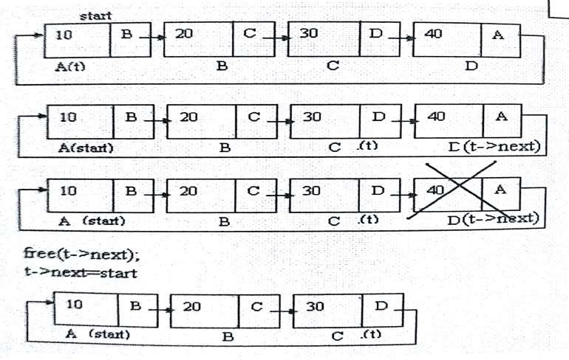
Delete from last
Circular Link List(CO1)

Slide 89
Algorithm
Circular Link List(CO1)
Program
Void dellast()
{
struct node *t=start;
if (start==NULL)
printf(“\nempty list”); else if (start->next==start)
{
free (t); start=NULL ;
}
else
{
while(t->next->next!=start)
t=t->next; free(t->next); t->next=start;
}
}
start.
Check if (start=NULL) then, print “empty list”
Check if (start->next=start)
then,
declare free (t) set start:=NULL otherwise
Repeat step(a)
while(t->next->next!=start)
▫ (a) set t:=t->next
[end of loop]
Declare free(t->next).
Set t->next:=start.
[end if]
stop

Slide 90
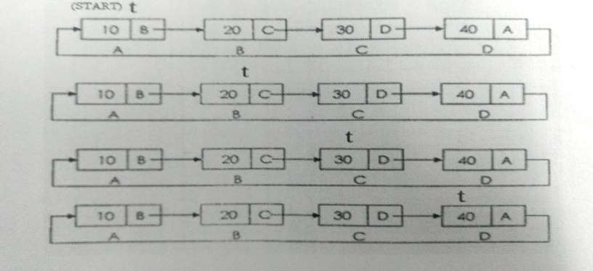
Display
Circular Link List(CO1)

Slide 91
Algorithm
Circular Link List(CO1)
Program
start.
Set struct node
*t:=start.
Check if(start=NULL) then, print “empty list” otherwise
Repeat step a and b while(t->next!=start)
▫ (a) print t->info
▫ (b) set t:=t->next
[end of loop]
Print t->info [end if]
stop
Void display()
{
struct node *t=start;
if(start=NULL)
printf (“\nempty list”); else
{
while(t->next!=start)
{
printf(“%d”, t->info); t=t->next;
}
printf(“%d”, t->info);
}
}

Slide 92
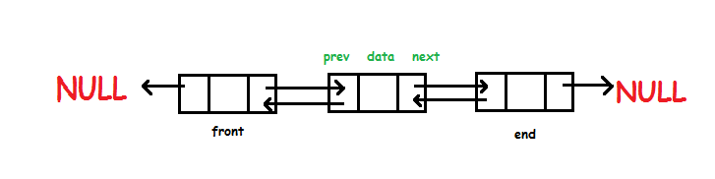
Link List(CO1)
Doubly Linked List
Doubly linked list is a type of linked list in which each node apart from storing its data has two links. The first link points to the previous node in the list and the second link points to the next node in the list. The first node of the list has its previous link pointing to NULL similarly the last node of the list has its next node pointing to NULL.
The two links help us to traverse the list in both backward and forward direction. But storing an extra link requires some extra space.

Slide 93
Link List(CO1)
First we define the node.
struct node
{
int data; // Data
node *prev; // A reference to the previous node
node *next; // A reference to the next node
};

Slide 94
Link List(CO1)
Important Points to be Remembered In double linked list, the first node must be always pointed by head. Always the previous field of the first node must be NULL. Always the next field of the last node must be NULL

Slide 95
Link List(CO1)
Operations on Double Linked List
In a double linked list, we perform the following operations...
1. Insertion
2. Deletion
3. Display

Slide 96
Link List(CO1)
Insertion
In a double linked list, the insertion operation can be performed in three ways as follows...
1. Inserting At Beginning of the list
2. Inserting At End of the list
3. Inserting At Specific location in the list

Slide 97
Link List(CO1)
Inserting At Beginning of the list
We can use the following steps to insert a new node at beginning of the double linked list...
• Step 1 - Create a newNode with given value and newNode → previous as NULL.
• Step 2 - Check whether list is Empty (head == NULL)
• Step 3 - If it is Empty then, assign NULL to newNode → next and newNode to head.
• Step 4 - If it is not Empty then, assignnewNode → next=head, head->prev = NULL and head= newNode.

Slide 98
Link List(CO1)
Inserting At End of the list
We can use the following steps to insert a new node at end of the double linked list...
• Step 1 - Create a newNode with given value and newNode → next as NULL.
• Step 2 - Check whether list is Empty (head == NULL)
• Step 3 - If it is Empty, then assign NULL to newNode → previous and newNode to head.
• Step 4 - If it is not Empty, then, define a node pointer temp and initialize with head.
• Step 5 - Keep moving the temp to its next node until it reaches to the last node in the list (until temp → next is equal to NULL).
• Step 6 - Assign newNode to temp → next and temp to newNode → previous.

Slide 99
Link List(CO1)
Inserting At Specific location in the list (After a Node)
We can use the following steps to insert a new node after a node in the double linked list...
• Step 1 - Create a newNode with given value.
• Step 2 - Check whether list is Empty (head == NULL)
• Step 3 - If it is Empty then, assign NULL to both newNode → previous & newNode → next and set newNode to head.
• Step 4 - If it is not Empty then, define two node pointers temp1 & temp2 and initialize temp1 with head.
• Step 5 - Keep moving the temp1 to its next node until it reaches to the node after which we want to insert the newNode (until temp1 → data is equal to location, here location is the node value after which we want to insert the newNode).
• Step 6 - Every time check whether temp1 is reached to the last node. If it is reached to the last node then display 'Given node is not found in the list!!! Insertion not possible!!!' and terminate the function. Otherwise move the temp1 to next node.
• Step 7 - Assign temp1 → next to temp2, newNode to temp1 → next, temp1 to newNode → previous, temp2 to newNode → next and newNode to temp2 → previous.

Slide 100
Link List(CO1)
Deletion
In a double linked list, the deletion operation can be performed in three ways as follows...
1. Deleting from Beginning of the list
2. Deleting from End of the list
3. Deleting a Specific Node

Slide 101
Link List(CO1)
Deleting from Beginning of the list
We can use the following steps to delete a node from beginning of the double linked list...
• Step 1 - Check whether list is Empty (head == NULL)
• Step 2 - If it is Empty then, display 'List is Empty!!! Deletion is not possible' and terminate the function.
• Step 3 - If it is not Empty then, define a Node pointer 'temp' and initialize with head.
• Step 4 - Check whether list is having only one node (temp → previous is equal to temp → next)
• Step 5 - If it is TRUE, then set head = NULL and delete temp (Setting Empty list conditions)
• Step 6 - If it is FALSE, then assign head=temp → next, head → previous =NULL and delete temp.

Slide 102
Link List(CO1)
Deleting from End of the list
We can use the following steps to delete a node from end of the double linked list...
• Step 1 - Check whether list is Empty (head == NULL)
• Step 2 - If it is Empty, then display 'List is Empty!!! Deletion is not possible' and terminate the function.
• Step 3 - If it is not Empty then, define a Node pointer 'temp' and initialize with head.
• Step 4 - Check whether list has only one Node (temp → previous and temp → next both are NULL)
• Step 5 - If it is TRUE, then assign NULL to head and delete temp. And terminate from the function. (Setting Empty list condition)
• Step 6 - If it is FALSE, then keep moving temp until it reaches to the last node in the list. (until temp → next is equal to NULL)
• Step 7 - Assign NULL to temp → previous → next and delete temp.

Slide 103
Link List(CO1)
Deleting a Specific Node from the list
We can use the following steps to delete a specific node from the double linked list...
• Step 1 - Check whether list is Empty (head == NULL)
• Step 2 - If it is Empty then, display 'List is Empty!!! Deletion is not possible' and terminate the function.
• Step 3 - If it is not Empty, then define a Node pointer 'temp' and initialize with head.
• Step 4 - Keep moving the temp until it reaches to the exact node to be deleted or to the last node.
• Step 5 - If it is reached to the last node, then display 'Given node not found in the list! Deletion not possible!!!' and terminate the fuction.
• Step 6 - If it is reached to the exact node which we want to delete, then check whether list is having only one node or not

Slide 104
Link List(CO1)
Step 7 - If list has only one node and that is the node which is to be deleted then set head to NULL and delete temp (free(temp)).
• Step 8 - If list contains multiple nodes, then check whether temp is the first node in the list (temp == head).
• Step 9 - If temp is the first node, then move the head to the next node (head = head → next), set head of previous to NULL (head → previous = NULL) and delete temp.
• Step 10 - If temp is not the first node, then check whether it is the last node in the list (temp → next == NULL).
• Step 11 - If temp is the last node then set temp of previous of next to NULL (temp → previous → next = NULL) and delete temp (free(temp)).
• Step 12 - If temp is not the first node and not the last node, then set temp of previous of next to temp of next (temp → previous → next = temp → next), temp of next of previous to temp of previous (temp → next → previous = temp → previous) and delete temp (free(temp)).

Slide 105
Link List(CO1)
Displaying a Double Linked List
We can use the following steps to display the elements of a double linked list...
• Step 1 - Check whether list is Empty (head == NULL)
• Step 2 - If it is Empty, then display 'List is Empty!!!' and terminate the function.
• Step 3 - If it is not Empty, then define a Node pointer 'temp' and initialize with head.
• Step 4 - Display 'NULL <--- '.
• Step 5 - Keep displaying temp → data with an arrow (<===>) until temp reaches to the last node
• Step 6 - Finally, display temp → data with arrow pointing to NULL (temp → data ---> NULL).

Slide 106
Link List(CO1)
void insertafter()
{
struct node *temp=head,*q,*newnode;
int element,n;
printf("enter element after which insertion to be done\n");
scanf("%d",&element);
printf("enter the data to be inserted");
scanf("%d",&n);
while(temp !=NULL) {
if(temp->info==element) {
q=temp->next;
newnode = (struct node*)malloc(sizeof(newnode));
newnode->data = n;
temp->next=newnode;
newnode->next=q;
newnode->prev=temp;
q->prev=newnode; }
temp=temp->next;
}

Slide 107
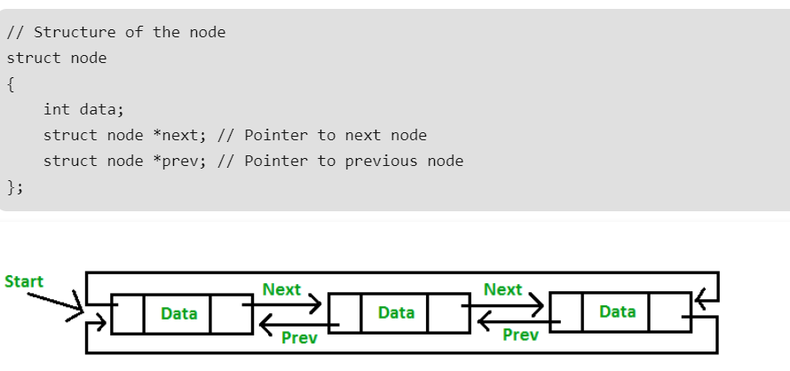
Link List(CO1)
Doubly Circular Linked List
Circular Doubly Linked List has properties of both doubly linked list and circular linked list in which two consecutive elements are linked or connected by previous and next pointer and the last node points to first node by next pointer and also the first node points to last node by previous pointer.

Slide 108
Link List(CO1)
Advantages:
List can be traversed from both the directions i.e. from head to tail or from tail to head.
Jumping from head to tail or from tail to head is done in constant time O(1).
Circular Doubly Linked Lists are used for implementation of advanced data structures like Fibonacci Heap.
Disadvantages
It takes slightly extra memory in each node to accommodate previous pointer.
Lots of pointers involved while implementing or doing operations on a list. So, pointers should be handled carefully otherwise data of the list may get lost.
Applications of Circular doubly linked list
Managing songs playlist in media player applications.
Managing shopping cart in online shopping.

Slide 109
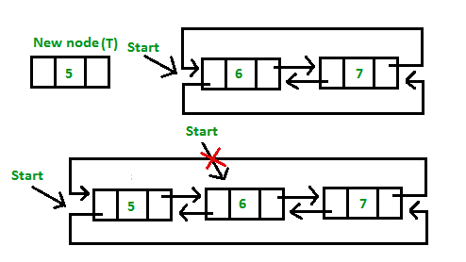
Link List(CO1)
Insertion at the beginning of the list:

Slide 110
Link List(CO1)
void insertBegin(int value)
{
struct node* new_node = malloc(sizeof(struct node));
new_node->data = value;
if (head== NULL)
{
new_node->next = new_node->prev = new_node;
head= new_node;
return;
}
// Pointer points to last Node
struct node *last = (head)->prev;
// setting up previous and next of new node
new_node->next = head;
new_node->prev = last;
// Update next and previous pointers of start
// and last.
last->next = head->prev = new_node;
// Update start pointer
head = new_node;
}

Slide 111
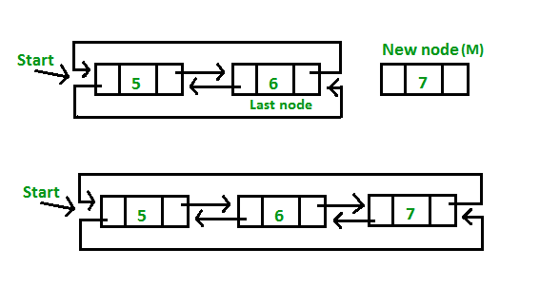
Link List(CO1)
Insertion at the end of list or in an empty list

Slide 112
Link List(CO1)
// Function to insert at the end
void insertEnd( int value)
{
// If the list is empty, create a single node
struct node* new_node = malloc(sizeof(struct node));
new_node->data = value;
if (head == NULL)
{
new_node->next = new_node;
new_node->prev = new_node;
head = new_node;
return;
}
// If list is not empty
/* Find last node */
struct node *last = (head)->prev;
// head is going to be next of new_node
new_node->next = head;
// Make new node previous of start
(head)->prev = new_node;
// Make last preivous of new node
new_node->prev = last;
// Make new node next of old last
last->next = new_node;
}

Slide 113
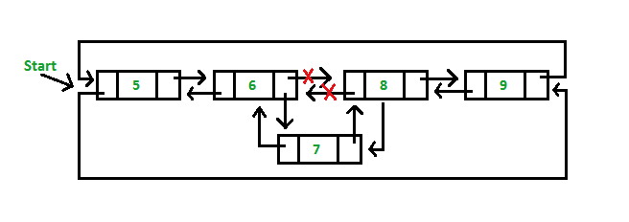
Link List(CO1)
Insertion in between the nodes of the list:

Slide 114
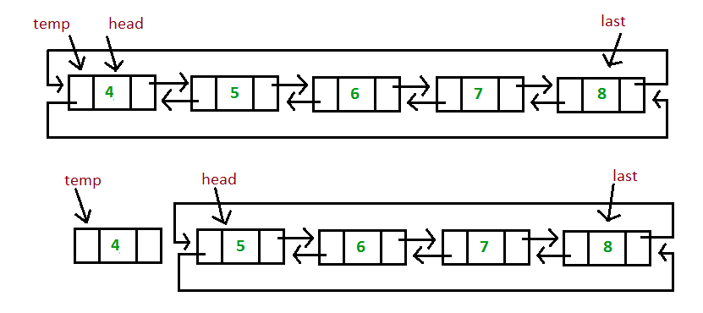
Link List(CO1)
Deletion from the beginning of the doubly circular link list:

Slide 115
Link List(CO1)
Deletion from the beginning of the doubly circular link list:
void delfrombeg()
{
struct node *temp,*last;
temp = head;
if(head == NULL)
{
printf(“Link List is empty”);
return;
}
else if(head->prev==head→next)
head = NULL; else{
last = temp->prev;
head = temp->next;
head - >prev = last;
last->next = head;
free(temp);}
}

Slide 116

Link List(CO1)
Deletion from the end of the doubly circular link list:

Slide 117
Link List(CO1)
Deletion from the end of the doubly circular link list:
void delfromend()
{
struct node *temp,*curr;
if(head == NULL)
{
printf(“Link List is empty”);
return;
}
else if(head->prev==head→next)
head = NULL;
else{
curr = head>prev;
temp = curr->prev;
head - >prev = temp;
temp->next = head;}
free(curr);
}

Slide 118
Link List(CO1)
Delete A Node By Key From Circular Double Link List
void deleteNode(int key)
{
if (head == NULL)
return;
struct Node *curr = head, *prev_1 = NULL;
while (curr->data != key) {
// If node is not present in the list
if (curr->next == head) {
printf("\nList doesn't have node value ");
return; }
prev_1 = curr;
curr = curr->next;
}
if (curr->next == head && prev_1 == NULL) {
(head) = NULL;
free(curr); return; }
// If list has more than one node,
// check if it is the first node
if (curr == head) {
// Move prev_1 to last node
prev_1 = (head)->prev;
// Move start ahead
head = (head)->next;
// Adjust the pointers of prev_1 and start node
prev_1->next = head;
(head)->prev = prev_1;
free(curr);
}

Slide 119
Link List(CO1)
// check if it is the last node
else if (curr->next == head) {
// Adjust the pointers of prev_1 and start node
prev_1->next = head;
(head)->prev = prev_1;
free(curr);
}
else {
// create new pointer, points to next of curr node
struct Node* temp = curr->next;
// Adjust the pointers of prev_1 and temp node
prev_1->next = temp;
temp->prev = prev_1;
free(curr);
}
}

Slide 120
Application of linked List
The cache in your browser that allows you to hit the BACK button (a linked list of URLs)
Undo functionality in Photoshop or Word (a linked list of state)
A stack, hash table, and binary tree can be implemented using a doubly linked list.

Slide 121

Linked Representation of Sparse Matrix
Introduction to Link List(CO1)
In linked list, each node has four fields. These four fields are defined as:
Row: Index of row, where non-zero element is located
Column: Index of column, where non-zero element is located
Value: Value of the non zero element located at index – (row , column)
Next node: Address of the next node

Slide 122
Introduction to Link List(CO1)
void removeDuplicates(struct Node *start) {
struct Node *ptr1, *ptr2, *dup;
ptr1 = start;
/* Pick elements one by one */
while (ptr1 != NULL && ptr1->next != NULL)
{
ptr2 = ptr1;
/* Compare the picked element with rest of the elements */
while (ptr2->next != NULL)
{
/* If duplicate then delete it */
if (ptr1->data == ptr2->next->data)
{
/* sequence of steps is important here */
dup = ptr2->next;
ptr2->next = ptr2->next->next;
dup ->next->prev=ptr2;
delete(dup);
}
else
ptr2 = ptr2->next;
}
ptr1 = ptr1->next;
}
}

Slide 123
Introduction to Link List(CO1)
Polynomials
Polynomials are the algebraic expressions which consist of variables and coefficients.
Example -
10x² + 26x, here 10 and 26 are coefficients and 2, 1 is its exponential value.
Polynomial can be represented in the various ways. These are:
By the use of arrays
By the use of Linked List

Slide 124
Link List(CO1)
Polynomials
Array Implementation:
p1(x) = 8x³ + 3x² + 2x + 6
p2(x) = 23x⁴ + 18x - 3
p1(x)
p2(x)
6 | 2 | 3 | 8
-3 | 18 | 0 | 0 | 23
0
2
0
2
4
Index represents exponents

Slide 125
Link List(CO1)
This is why arrays aren’t good to represent polynomials:
p3(x) = 16x²¹ - 3x⁵ + 2x + 6
6 | 2 | 0 | 0 | -3 | 0 | ………… | 0 | 16
WASTE OF SPACE!

Slide 126
Link List(CO1)
Add Two Polynomials Using Arrays
Input: A[] = {5, 0, 10, 6} B[] = {1, 2, 4}
Output: sum[] = {6, 2, 14, 6}
The first input array represents "5 + 0x^1 + 10x^2 + 6x^3"
The second array represents "1 + 2x^1 + 4x^2"
And Output is "6 + 2x^1 + 14x^2 + 6x^3“
add(A[0..m-1], B[0..n01])
1) Create a sum array sum[] of size equal to maximum of 'm' and 'n'
2) Copy A[] to sum[].
3) Traverse array B[] and do following for every element B[i]
sum[i] = sum[i] + B[i]
4) Return sum[].

Slide 127
Link List(CO1)
Advantages of using an Array:
Only good for non-sparse polynomials.
Ease of storage and retrieval.
Disadvantages of using an Array:
Have to allocate array size priorly.
Huge array size required for sparse polynomials. Waste of space and runtime.

Slide 128

Link List(CO1)
Polynomial Representation
Linked list Implementation:
p1(x) = 23x⁹ + 18x⁷ + 41x⁶ + 163x⁴ + 3
p2(x) = 4x⁶ + 10x⁴ + 12x + 8
23 9
18 7
41 6
163 4
3
P1
0
Next (contains pointer)
4 6
10 4
12 1
8 0
P2
NODE (contains coefficient & exponent)

Slide 129
Link List(CO1)
Advantages of using a Linked list:
Save space (don’t have to worry about sparse polynomials) and easy to maintain.
Don’t need to allocate list size and can declare nodes (terms) only as needed.
Disadvantages of using a Linked list :
Can’t go backwards through the list can’t jump to the beginning of the list from the end.

Slide 130


Polynomials
Link List(CO1)
A(x)
^{e}m 1
a_{m 1} x a_{m}
^{e}m 2 ^{e}0
₂ x ... a₀ x
Representation
struct polynode {
int coef;
int exp;
struct polynode * next;
};
typedef struct polynode *polyptr;
coef | exp | next

Slide 131

Link List(CO1)

Slide 132

Deletion in a Linked List
Deletion is also a more than one step process. We shall learn with pictorial representation. First, locate the target node to be removed, by using searching algorithms.

Slide 133

Deletion in a Linked List (contd..)
The left (previous) node of the target node now should point to the next node of the target node −
LeftNode.next −> TargetNode.next;

Slide 134

Deletion in a Linked List (contd..)
This will remove the link that was pointing to the target node. Now, using the following code, we will remove what the target node is pointing at.
TargetNode.next −> NULL;

Slide 135

Deletion in a Linked List (contd..)
We need to use the deleted node. We can keep that in memory otherwise we can simply deallocate memory and wipe off the target node completely.

Slide 136
Polynomial Representation (CO3)
A polynomial p(x) is the expression in variable x which is in the form (ax^{n} + bx^{n-1} + …. + jx+ k), where a, b, c …., k fall in the category of real numbers and 'n' is non negative integer, which is called the degree of polynomial.
An essential characteristic of the polynomial is that each term in the polynomial expression consists of two parts:
one is the coefficient
other is the exponent
Example:
10x² + 26x,
here 10 and 26 are coefficients and 2, 1 is its exponential value.

Slide 137

Polynomial Representation
Points to keep in Mind while working with Polynomials:
The sign of each coefficient and exponent is stored within the coefficient and the exponent itself
Additional terms having equal exponent is possible one
The storage allocation for each term in the polynomial must be done in ascending and descending order of their exponent

Slide 138
Polynomial Representation
Addition of polynomial
eg.
1) Input: 1st number = 5x² + 4x¹ + 2x⁰
2nd number = -5x¹ - 5x⁰
Output: 5x²-1x¹-3x⁰
2) Input: 1st number = 5x³ + 4x² + 2x⁰
2nd number = 5x^1 - 5x^0
Output: 5x³ + 4x² + 5x¹ - 3x⁰

Slide 139
Polynomial Representation
Subtraction of polynomial
Input: 1st number = 5x² + 4x¹ + 2x⁰
2nd number = -5x¹ - 5x⁰
Output: 5x² + 9x¹ + 7x⁰

Slide 140

Polynomial Representation
Multiplication of polynomial
Input: Poly1: 3x^2 + 5x^1 + 6, Poly2: 6x^1 + 8
Output: 18x^3 + 54x^2 + 76x^1 + 48

Slide 141
Stack Implementation using Linked List
Using List as Stack and Queues in Python (tutorialspoint.com)

Slide 142
Queue Implementation using Linked List
Using List as Stack and Queues in Python (tutorialspoint.com)

Slide 143
Daily Quiz
Which of the following is not a disadvantage to the usage of array?
a) Fixed size
b) There are chances of wastage of memory space if elements inserted in an array are lesser than the allocated size
c) Insertion based on position
d) Accessing elements at specified positions
What is the time complexity to count the number of elements in the linked list?
a) O(1)
b) O(n)
c) O(logn)
d) O(n2)

Slide 144
Daily Quiz
What is the space complexity for deleting a linked list?
a) O(1)
b) O(n)
c) Either O(1) or O(n)
d) O(logn)
What differentiates a circular linked list from a normal linked list?
a) You cannot have the ‘next’ pointer point to null in a circular linked list
b) It is faster to traverse the circular linked list
c) You may or may not have the ‘next’ pointer point to null in a circular linked list
d) Head node is known in circular linked list

Slide 145
Weekly Assignment
Define data structure and explain types of data structure with suitable examples
What are the primitive operations in any data structure
Explain the asymptotic notations with suitable examples
Differentiate between space and time complexity of an algorithm
Write an algorithm for merging two already sorted arrays
Write an algorithm/program for insert a node at between any position of a linked list
Write an algorithm/program to reverse a linked list
Write an algorithm/program to sort two linked lists
Write an algorithm/program to add two polynomials by using linked list
what are the applications of a single linked list, doubly linked list and circular linked list

Slide 146
MCQ s
Which of these best describes an array? a) A data structure that shows a hierarchical behaviour b) Container of objects of similar types c) Arrays are immutable once initialised d) Array is not a data structure
How do you initialize an array in C? a) int arr[3] = (1,2,3); b) int arr(3) = {1,2,3}; c) int arr[3] = {1,2,3}; d) int arr(3) = (1,2,3);

Slide 147
MCQ s
In the worst case, the number of comparisons needed to search a singly linked list of length n for a given element is (GATE CS 2002)
A log 2 n
B n/2
C log 2 n – 1
D n
You are given pointers to first and last nodes of a singly linked list, which of the following operations are dependent on the length of the linked list?
A Delete the first element
B Insert a new element as a first element
C Delete the last element of the list
D Add a new element at the end of the list

Slide 148
MCQ s
What are the advantages of arrays? a) Objects of mixed data types can be stored b) Elements in an array cannot be sorted c) Index of first element of an array is 1 d) Easier to store elements of same data type
Elements in an array are accessed _____________ a) randomly b) sequentially c) exponentially d) logarithmically

Slide 149
MCQ s
In linked list each node contain minimum of two fields. One field is data field to store the data second field is? A. Pointer to character B. Pointer to integer C. Pointer to node D. Node
Linked list data structure offers considerable saving in
A. Computational Time B. Space Utilization C. Space Utilization and Computational Time D. None of the mentioned

Slide 150
Glossary Question
i. Linked list ii. Abstract Data type iii.Asymptotic Analysis iv. Linear order
Answer the questions.
a. Another term for total order.
b. A process followed to solve a problem.
c. The specification of a data type with some language.
d. Dynamic allocation of link nodes to store the list of elements.

Slide 151
Old Question Papers
http://www.aktuonline.com/papers/btech-cs-3-sem-data-structures-kcs301-2020.html
http://www.aktuonline.com/papers/btech-cs-3-sem-data-structures-rcs-305-2018-19.html
http://www.aktuonline.com/papers/btech-cs-3-sem-data-structures-rcs-305-2017-18.html
http://www.aktuonline.com/papers/btech-cs-3-sem-data-structures-using-c-ncs-301-2016-17.html
https://www.aktuonline.com/papers/btech-cs-3-sem-data-structures-kcs301-2020.html
https://firstranker.com/fr/frdA290120A1345373/download-aktu-b-tech-3rd-sem-2018-2019-data-structures-rcs-305-question-paper

Slide 152

Old Question Papers

Slide 153

Old Question Papers

Slide 154

Old Question Papers

Slide 155

Old Question Papers

Slide 156
Expected Questions for University Exam
What is doubly linked list? What are its applications? Explain how an element can be deleted from doubly linked list using C program.
What are the merits and demerits of array? Given two arrays of integers in ascending order, develop an algorithm to merge these arrays to form a third array sorted in ascending order.
How can you represent a sparse matrix in memory?
List the various operations on linked list.
What do you understand by time and space trade off?
Define the various asymptotic notations. Derive the O-notation for linear search.
Write a program in c to delete a specific element in single linked list. Double linked list takes more space than single linked list for storing one extra address. Under what condition, could a double linked list more beneficial than single linked list.

Slide 157
Summary
We consider two fundamental data types for storing collections of objects: the stack and the queue.
We implement each using either a singly-linked list or a resizing array.
We introduce two advanced Java features—generics and iterators—that simplify client code.
Finally, we consider various applications of stacks and queues ranging from parsing arithmetic expressions to simulating queueing systems.

Slide 158
References
Aaron M. Tenenbaum, Yedidyah Langsam and Moshe J. Augenstein, “Data Structures Using C and C++”, PHI Learning Private Limited, Delhi India
Horowitz and Sahani, “Fundamentals of Data Structures”, Galgotia Publications Pvt Ltd Delhi India.
Lipschutz, “Data Structures” Schaum’s Outline Series, Tata McGraw-hill Education (India) Pvt. Ltd.
Thareja, “Data Structure Using C” Oxford Higher Education.
AK Sharma, “Data Structure Using C”, Pearson Education India.
Michael T. Goodrich, Roberto Tamassia, David M. Mount “Data Structures and Algorithms in C++”, Wiley India.
. P. S. Deshpandey, “C and Data structure”, Wiley Dreamtech Publication.

Slide 159
Thank You

